Slide 1
BONE HEADPHONES
BY:
17BCE1043 – YOKESH
17BCE1094 – SANATHAN NARAYANAN
17BCE1169 – KRISHNA MANJUNATH
17BCE1210 – PRATIKSHA RAVISHANKAR
17BCE1264 – AMRITHA T

Slide 2
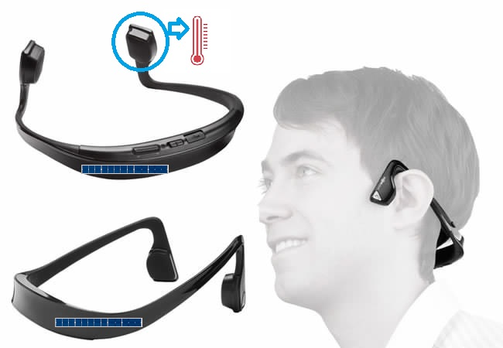
MINIMUM VIABLE PRODUCT

Slide 3
MINIMUM VIABLE PRODUCT
Can you always rely on customers to tell you their requirements?
No, as customers may not know the concept of ‘Bone Headphones’, ‘Brainwaves’, etc.
Customers may not know the importance of this product as they may be busy and may ignore questions.
They may not answer questions sincerely – highly depends on their emotional state.

Slide 4
MINIMUM VIABLE PRODUCT
Do consumers recognize that they have the problem you are trying to solve?
Yes, obviously everyone cares for people who are medically handicapped. Everyone will want to develop in medical area.
If there was a solution, would they buy it?
Yes, as for the above reasons
Would they buy it from us?
Yes, since we would be the first to do this and would produce it after extensive research. We will also do a lot of hard work in advertising area.

Slide 5
MINIMUM VIABLE PRODUCT
Can we build a solution for that problem?
Yes, after extensive research, we feel that it is easy to build the solution for “Making deaf people hear sound through our product”
Minimum Viable Product:
Bone headphones
Super Sensitive Solar Panel
Heating/Sweat Non Retaining cushions

Slide 6
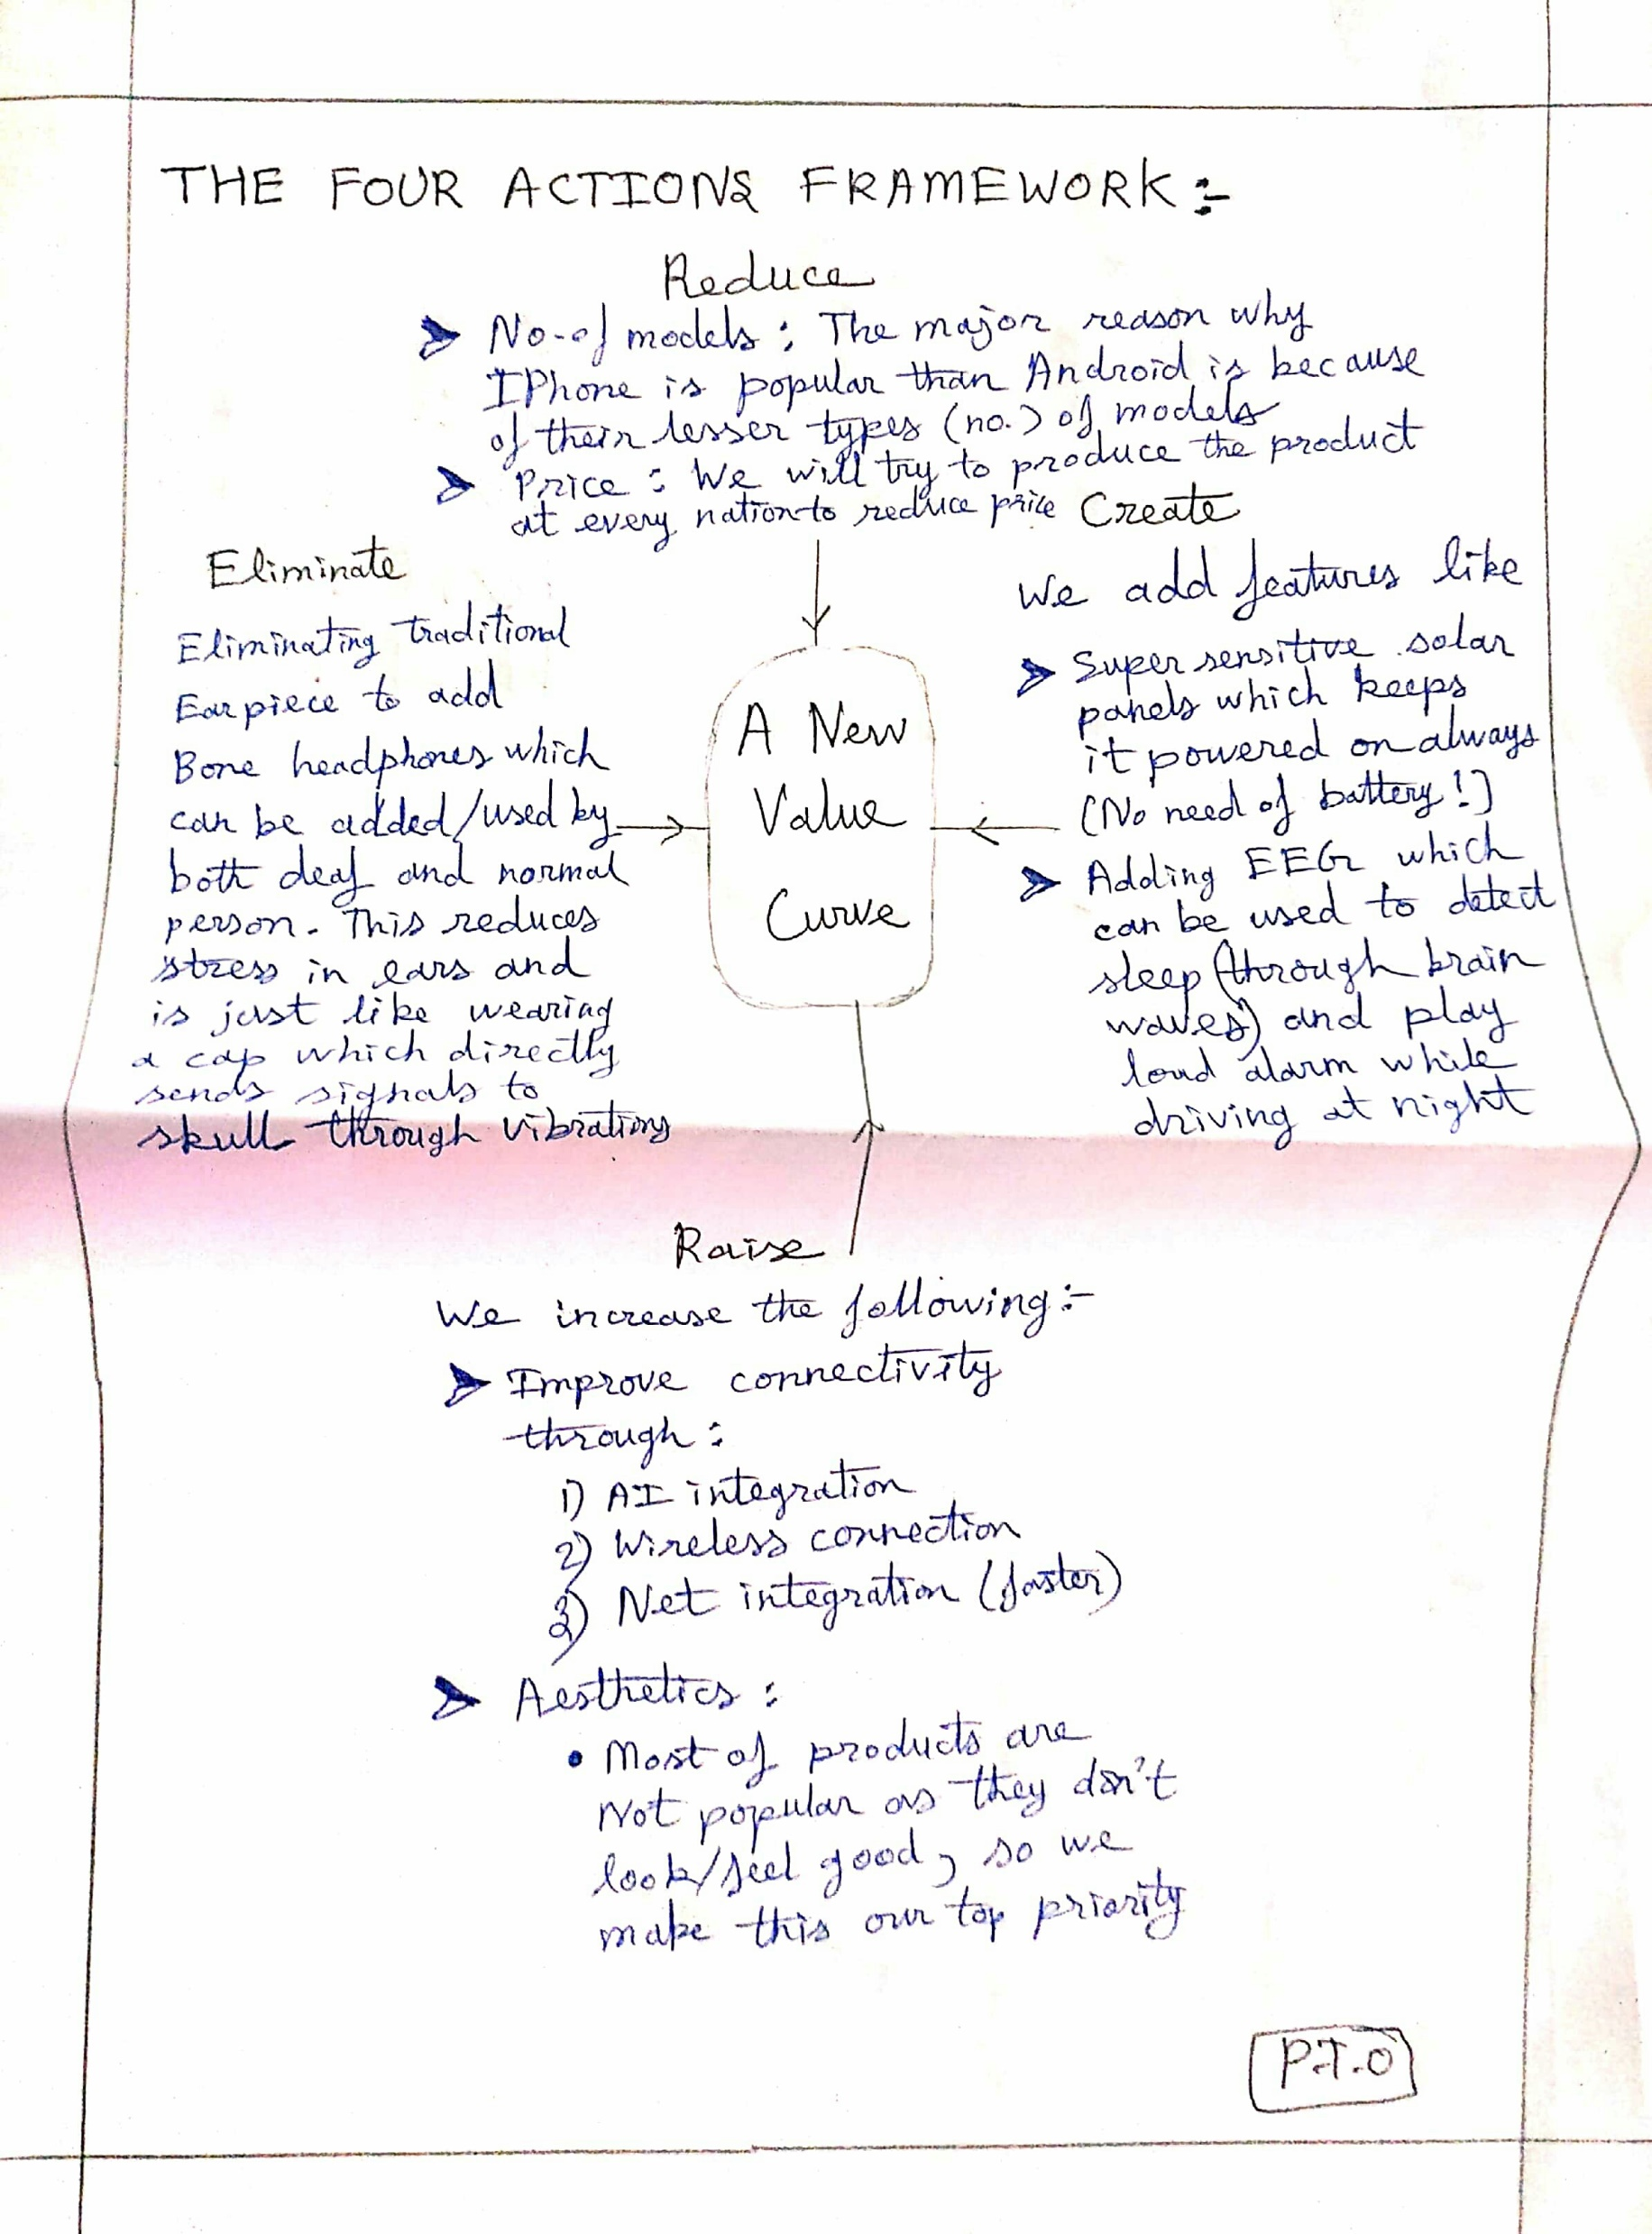

Slide 7
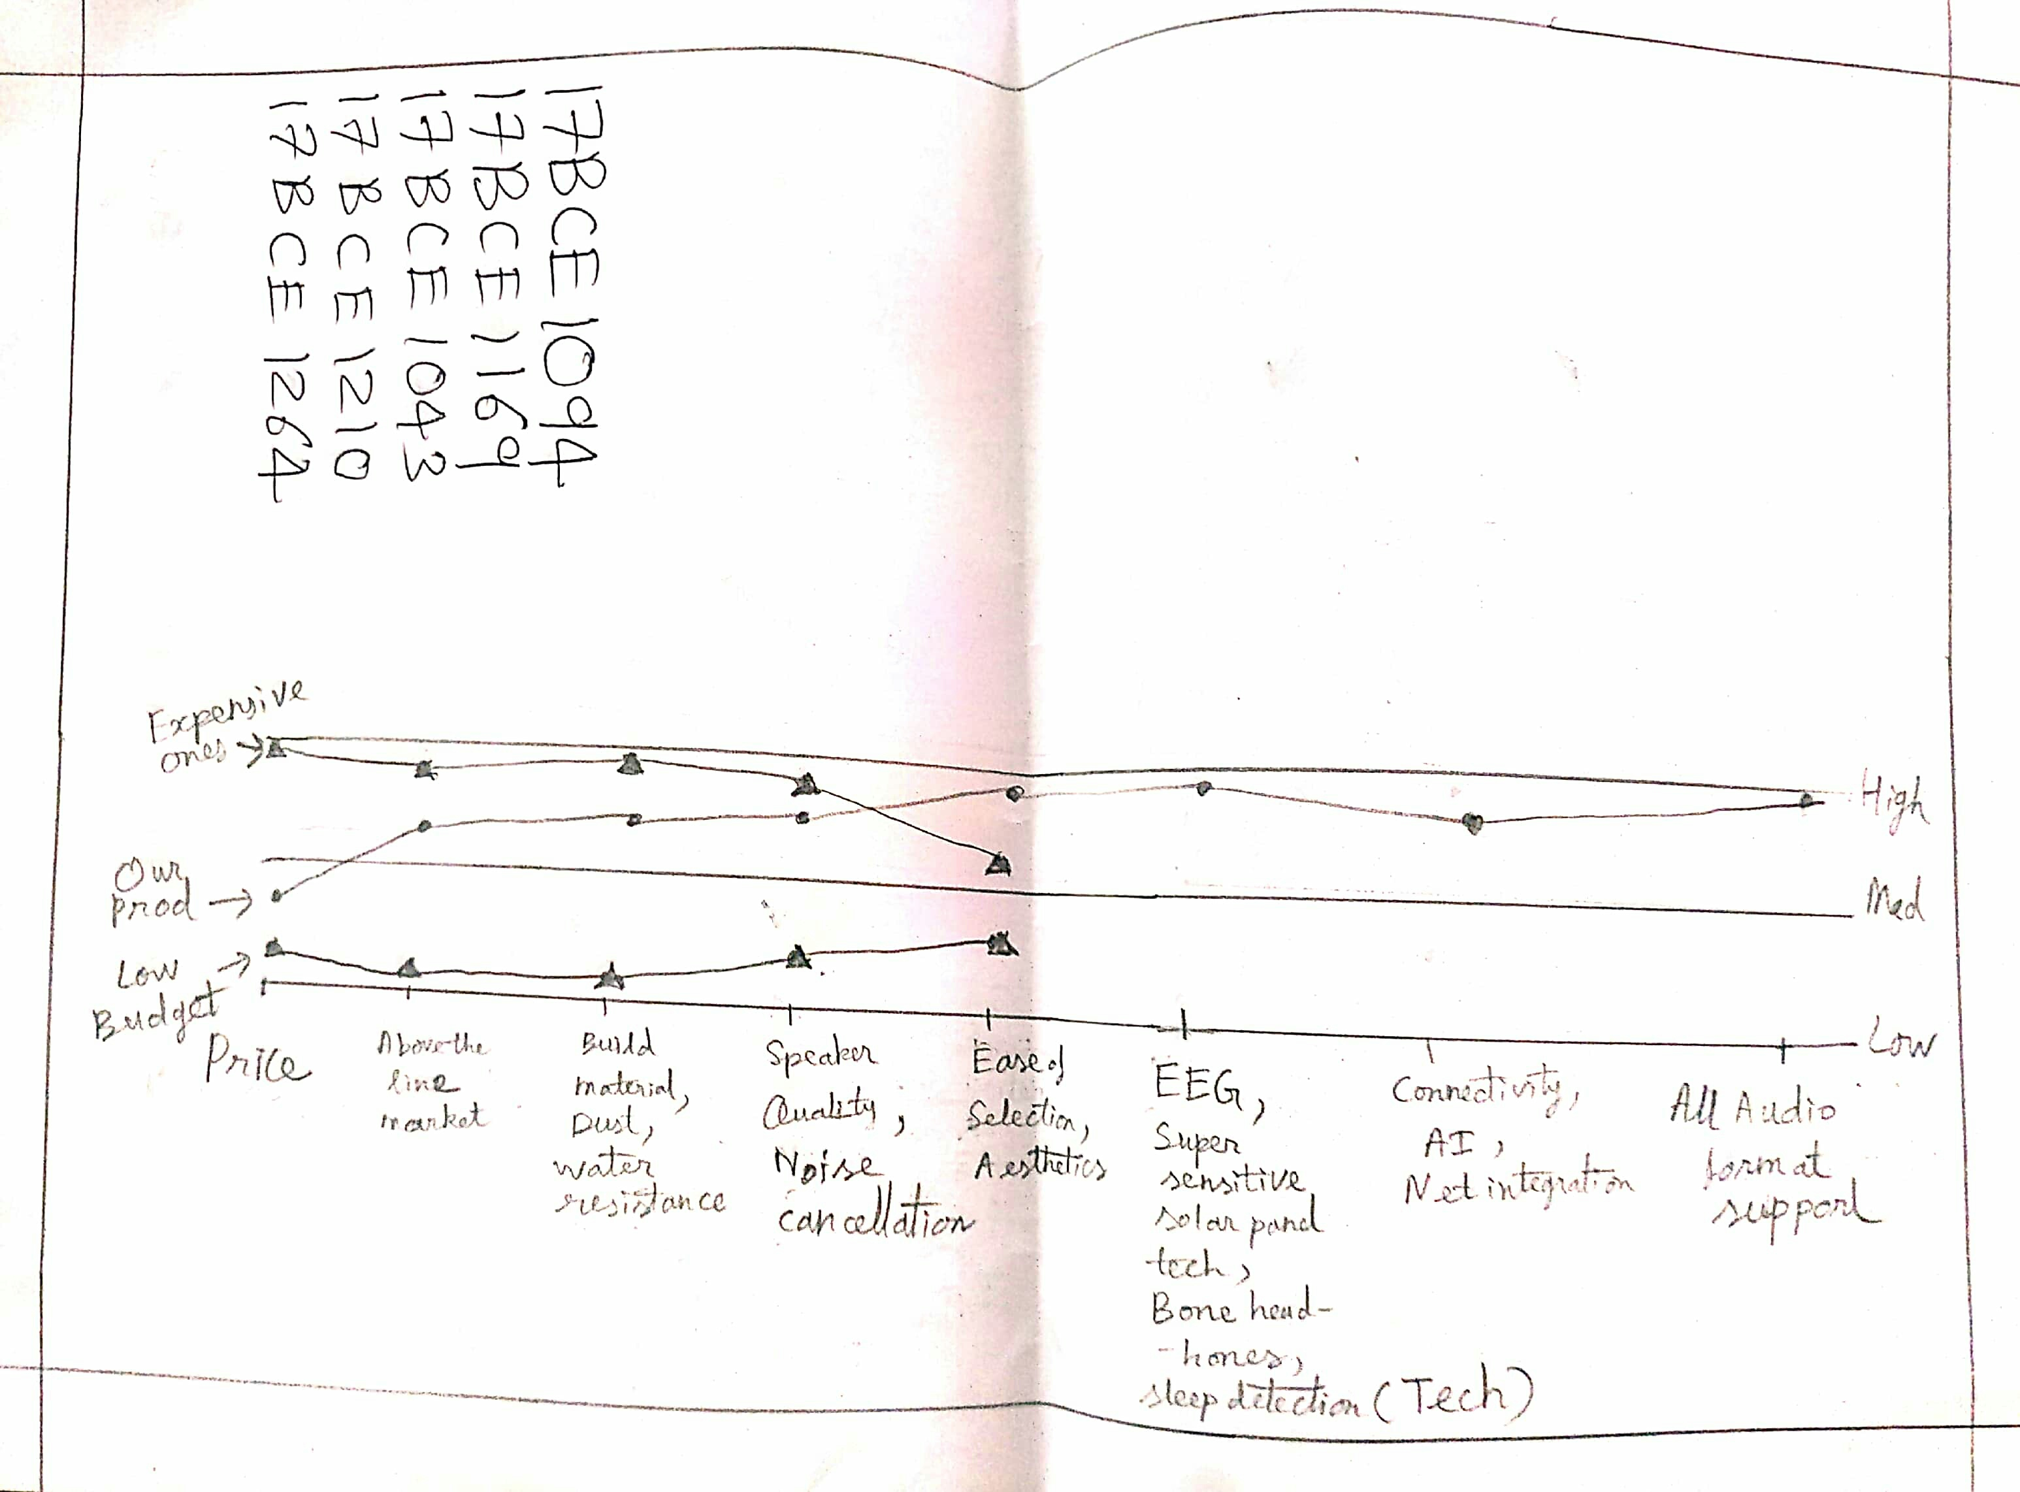

Slide 8
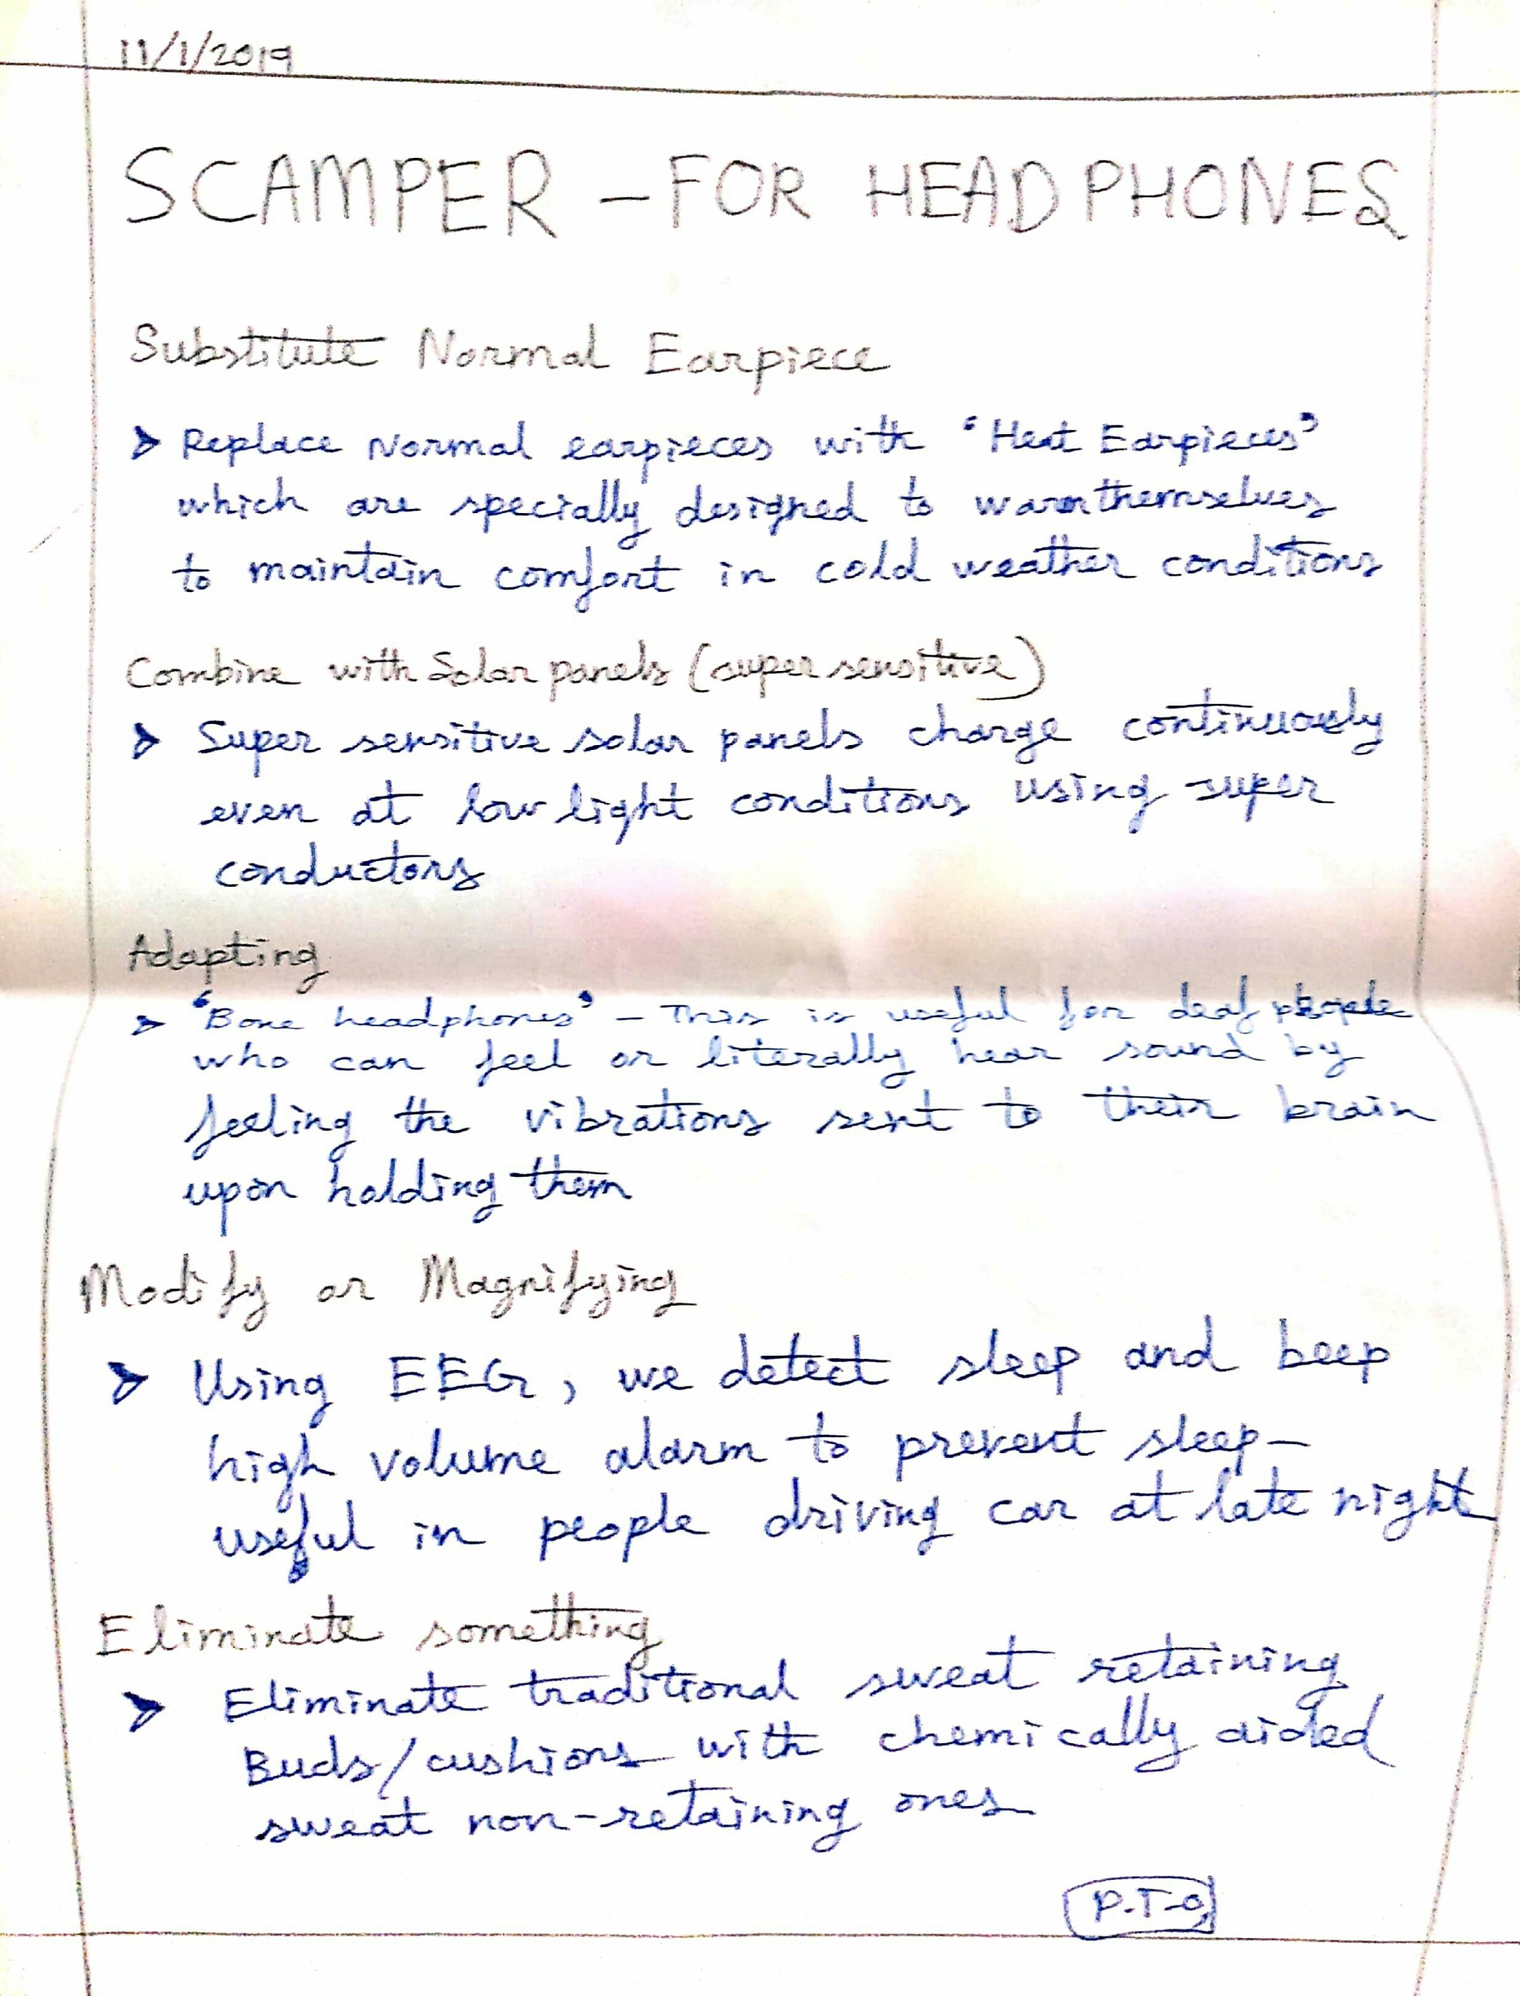

Slide 9
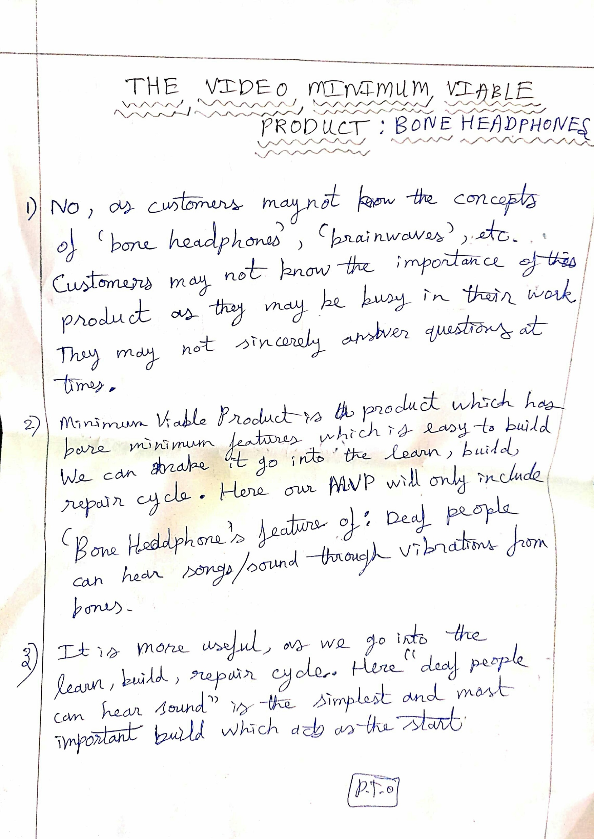

Slide 10
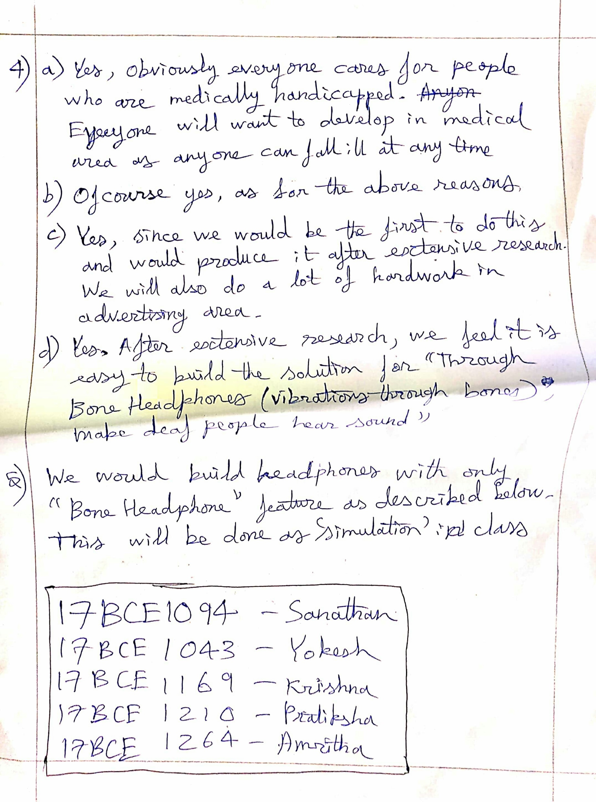

Slide 11
THANK YOU!

